Slide 1
CSE 512: Distributed and Parallel Data Systems
Lecture 6
Instructor: Mohamed Sarwat

Slide 2
Parallel Query Processing: Intro
Parallelism is natural to DBMS processing
  Pipeline parallelism: many machines each doing one step in a multi-step process.
  Partition parallelism: many machines doing the same thing to different pieces of data.
  Both are natural in DBMS!
Any
Any
Sequential
Sequential
Pipeline
Program
Program
Sequential
Any
Any
Partition
Sequential
Sequential
Sequential
Sequential
Sequential
Program
Program
outputs split N ways, inputs merge M ways

Slide 3
Some || Terminology
Ideal
Speed-Up
  More resources means proportionally less time for given amount of data.
Scale-Up
  If resources increased in proportion to increase in data size, time is constant.
Xact/sec.
(throughput)
degree of ||-ism
Ideal
sec./Xact
(response time)
degree of ||-ism

Slide 4
Architecture Issue: Shared What?
Shared Memory
(SMP)
Shared Disk
Shared Nothing
(network)
CLIENTS
CLIENTS
CLIENTS
Processors
Memory
Shared Memory Vs. Shared Nothing?
Notes:
101

Slide 5
Architecture Issue: Shared What?
Shared Memory
(SMP)
Shared Disk
Shared Nothing
(network)
CLIENTS
CLIENTS
CLIENTS
Processors
Memory
Easy to program
Expensive to build
Difficult to scaleup
Hard to program
Cheap to build
Easy to scaleup
Notes:
101

Slide 6
Different Types of DBMS ||-ism
Intra-operator parallelism
  get all machines working to compute a given operation (scan, sort, join)
Inter-operator parallelism
  each operator may run concurrently on a different site (exploits pipelining)
Inter-query parallelism
  different queries run on different sites

Slide 7
Automatic Data Partitioning
Partitioning a table:
Range Hash Round Robin
A...E
F...J
K...N
O...S
T...Z
A...E
F...J
K...N
O...S
T...Z
A...E
F...J
K...N
O...S
T...Z
Notes:
77

Slide 8
Automatic Data Partitioning
Partitioning a table:
Range Hash Round Robin
A...E
F...J
K...N
O...S
T...Z
A...E
F...J
K...N
O...S
T...Z
A...E
F...J
K...N
O...S
T...Z
Good for equijoins,
range queries
group-by
Good for equijoins
Good to spread load
Shared disk and memory less sensitive to partitioning,
Shared nothing benefits from "good" partitioning
Notes:
77

Slide 9
Parallel Scans
Scan in parallel, and merge.
Selection may not require all sites for range or hash partitioning.
Indexes can be built at each partition.

Slide 10
Parallel Sorting
e.g., Sort all Employees based on their age?

Slide 11
Parallel Sorting
Idea:
  Scan in parallel, and range-partition as you go.
  As tuples come in, begin “local” sorting on each
  Resulting data is sorted, and range-partitioned.
  Problem: skew!
  Solution: “sample” the data at start to determine partition points.

Slide 12
Parallel Joins
Nested loop:
  Each outer tuple must be compared with each inner tuple that might join.
  Easy for range partitioning on join cols, hard otherwise!
Sort-Merge (or plain Merge-Join):
  Sorting gives range-partitioning.
  Merging partitioned tables is local.

Slide 13
Complex Parallel Query Plans
Complex Queries: Inter-Operator parallelism
  Pipelining between operators:
    note that sort block the pipeline!!
  Bushy Trees
Sites 1-8
Sites 1-4
Sites 5-8
A
B
R
S

Slide 14
Questions

Slide 15
Data Management in MapReduce Systems

Slide 16

Large-Scale Data Processing

Slide 17
Hadoop
Hadoop MapReduce sucks
  Programming model is not generic enough
  The runtime environment of Hadoop performs a lot of unnecessary work.
Hadoop HDFS is awesome
  Very Scalable storage
  Efficient Replication
Hadoop Cluster Resource Management

Slide 18
MapReduce Architecture
User
Program
fork
fork
fork
Master
assign
map
assign
reduce
Input Data
Worker
write
Output
File 0
local
write
Worker
Split 0
read
Split 1
Worker
Split 2
Output
File 1
Worker
Worker
remote
read,
sort

Slide 19
How It Works
Distributed file system (HDFS)
  Single namespace for entire cluster
  Replicates data 3x for fault-tolerance
MapReduce framework
  Executes user jobs specified as “map” and “reduce” functions
  Manages work distribution & fault-tolerance

Slide 20
HDFS (1/2)
Files split into 128MB blocks
Blocks replicated across several DataNodes (usually 3)
NameNode stores metadata (file names, location)
Optimized for large files, sequential reads
Files are append-only

Slide 21
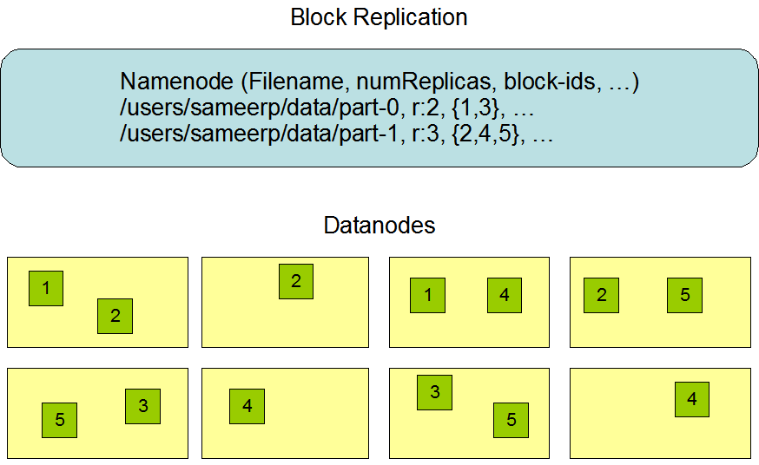
HDFS (2/2)
Centralized namenode
-Maintains metadata info about files
File F
1
2
3
4
5
Blocks (64 MB)
Many datanode (1000s)
- Store the actual data
- Files are divided into blocks
- Each block is replicated N times (Default = 3)

Slide 22
MapReduce Programming Model
Data type: key-value records
Map function:
  (Key1, Value1) ➔ list(Key2, Value2)
Reduce function:
  (Key2, list(Value2)) ➔ list(Key3, Value3)

Slide 23
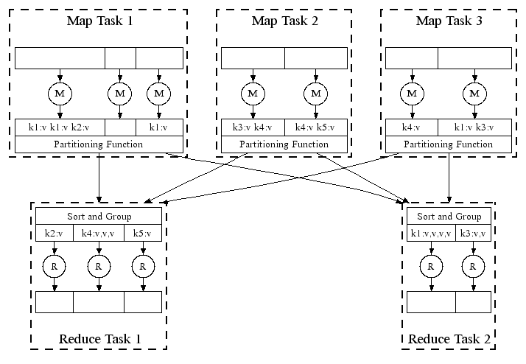
Parallel Execution
Notes:
View from scheduled m/c perspective

Slide 24
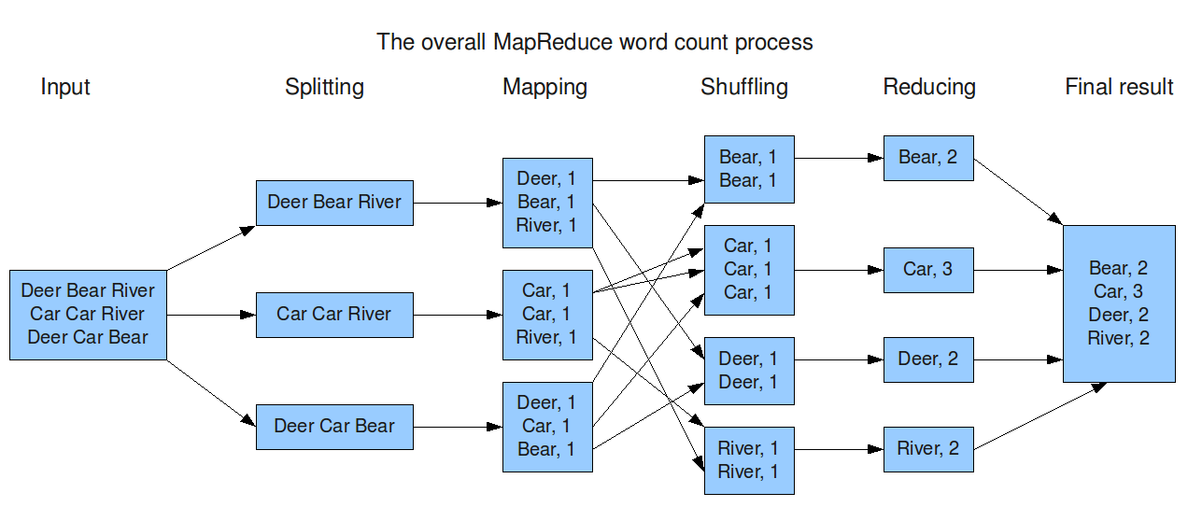
Example: Word Count

Slide 25
MapReduce Execution Details
Mappers preferentially placed on same node or same rack as their input block
  Push computation to data, minimize network use
Mappers save outputs to local disk before serving to reducers
  Allows having more reducers than nodes
  Allows recovery if a reducer crashes

Slide 26
Fault Tolerance in Hadoop
If a task crashes:
  Retry on another node
  OK for a map because it had no dependencies
  OK for reduce because map outputs are on disk
If the same task repeatedly fails, fail the job
If a node crashes:
  Re-launch its current tasks on other nodes
  Re-launch any maps the node previously ran
    Necessary because their output files were lost along with the crashed node

Slide 27
Fault Tolerance in Hadoop
If a task is going slowly (straggler):
  Launch second copy of task on another node
  Take the output of whichever copy finishes first, and kill the other one
Critical for performance in large clusters
(“everything that can go wrong will”)

Slide 28
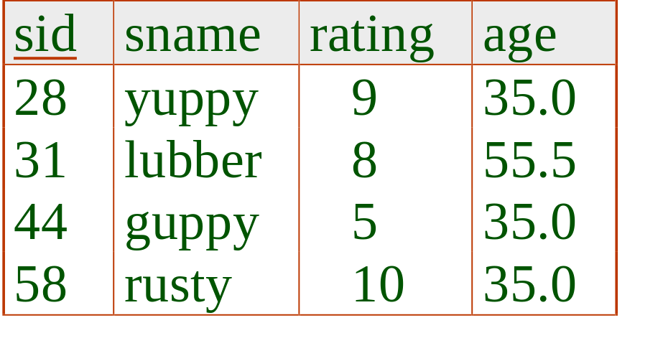
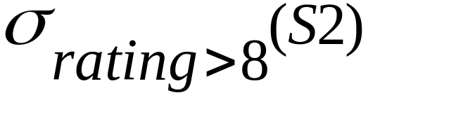
Selection Operator in MapReduce
S2

Slide 29
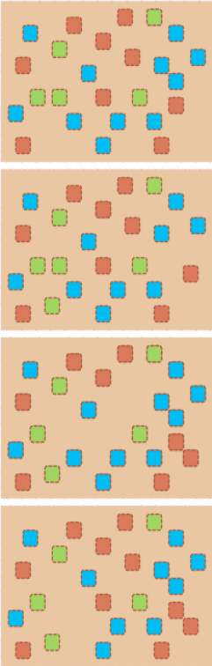
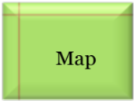
Example 3: Color Filter
Job: Select only the blue and the green colors
Input blocks on HDFS
Produces (k, v)
( , 1)
Each map task will select only the blue or green colors
No need for reduce phase
Write to HDFS
Part0001
Write to HDFS
Part0002
That’s the output file, it has 4 parts on probably 4 different machines
Write to HDFS
Part0003
Write to HDFS
Part0004

Slide 30
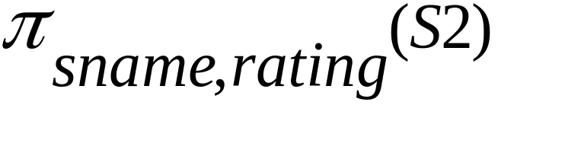
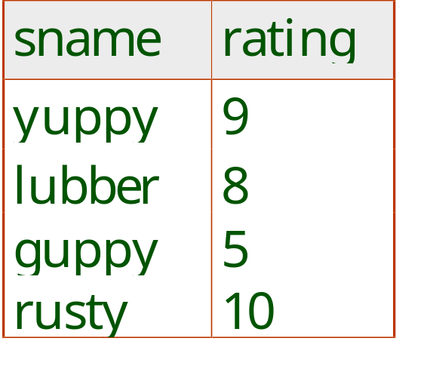
Projection Operator in MapReduce
S2

Slide 31
Sorting Operator in MapReduce
S2

Slide 32
Group By in MapReduce

Slide 33

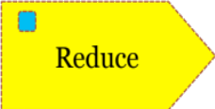
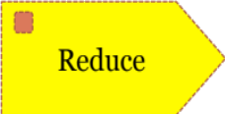
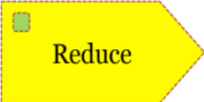
Example 2: Color Count
Job: Count the number of each color in a data set
Input blocks on HDFS
Produces (k, v)
( , 1)
Shuffle & Sorting based on k
Consumes(k, [v])
( , [1,1,1,1,1,1..])
Produces(k’, v’)
( , 100)
Part0001
Part0002
Part0003
That’s the output file, it has 3 parts on probably 3 different machines

Slide 34
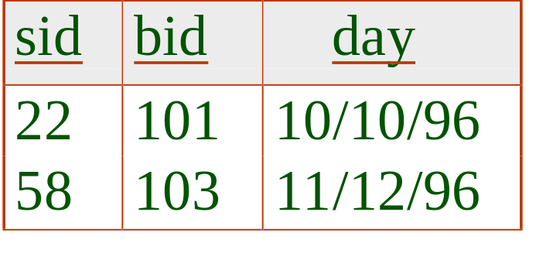
Join Operator in MapReduce
S2
R1

Slide 35
Questions

